Slide 1
Welcome! Please follow these instructions
Either grab a lab pc, or on your own pc connect to Big Koala
(password = putinattackhelicopter)
Go to 10.1.1.132
Make an account
The meeting will begin shortly!

Slide 2
Hacking Windows Systems
By Derek and Stanley

Slide 3
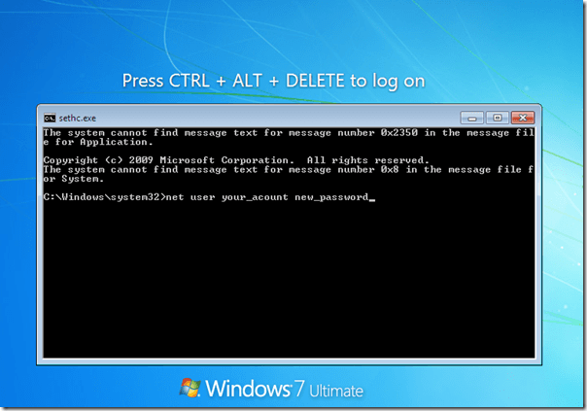
SYSTEM Shell on Winlogon Desktop
Live boot into another OS such as kali
Make a copy of c:\windows\system32\cmd.exe
Make a backup copy of c:\Windows\System32\sethc.exe
Replace original sethc.exe with the copy of cmd.exe
Boot windows up
Hit shift a bunch of times
HACKED

Slide 4
Adding an Admin account
Run the following commands to make a new account and add it to the administrators group:
net user hacker abcd /add
net localgroup administrators hacker /add

Slide 5
Cracking Windows Passwords
Passwords are stored in hashes in the following file:
C:\windows\system32\config\sam
The hashes are encrypted with a key stored in another file:
C:\windows\system32\config\security
Both files are required to obtain the hashes

Slide 6
Cracking Windows Passwords
Both of these files are protected by the OS so cannot be copied directly.
But they can be obtained using the registry utilities reg or regedit if you have administrative privileges
Reg is a command line utility and the commands are as follows:
REG SAVE HKLM\Sam c:\sam
REG SAVE HKLM\System c:\System
Regedit is a GUI
Open it up and expand HKEY_LOCAL_MACHINE
Right click on SAM and click export
Change the file type to Registry Hive Files
Repeat this for SYSTEM

Slide 7
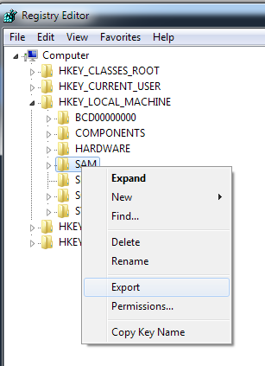
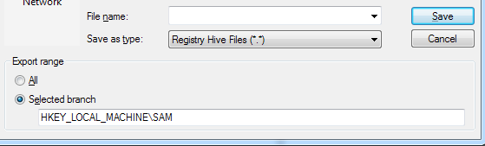

Slide 8
Extracting the Hashes
There’s a few tools to do this.
Pwdump7 and Cain and Abel are the two I use.
Pwdump7 was having issues on the vm so we’ll use cain and abel
Download it from oxid.it
Install it. Make sure to hit yes when it asks to install pcap drivers
Go to the cracker tab and click LM & NTLM hashes on the left
Click the plus button to import
Select the SAM file
To get the boot key, click the … button then click the second … button and select the SYSTEM file
Copy and paste the boot key into the text box

Slide 9
Extracting the Hashes
The hashes should now be displayed in the cracker window
Right click and hit export
Save the file and then open it with notepad
You should see lines that look like this
Administrator:"":"":AAD3B435B51404EEAAD3B435B51404EE:31D6CFE0D16AE931B73C59D7E0C089C0
The colons serve as delimiters and the format is as following
Username:::LM Hash:NTLM Hash
If the LM Hash is AAD3B435B51404EEAAD3B435B51404EE (empty hash) that means the password is only stored as an NT hash
LM Hashes are literally a joke to crack, so if it's not the hash mentioned above, you hit the jackpot!

Slide 10
LM Hashes
AAD3B435B51404EEAAD3B435B51404EE AAD3B435B51404EEA AD3B435B51404EE
AAD3B435B51404EE AAD3B435B51404EE
LM hashes are really two hashes appended to each other
Each hash supports a max of 7 characters (for a max length of 14 characters)
The password is converted to uppercase before being hashes
So yes, its a joke and can be cracked in a couple minutes

Slide 11
NT Hashes
Not a joke like LM
All systems starting with Vista / Server 2008 have LM hashes disabled by default and only use NT hashes

Slide 12
Cracking
Tons of tools available to crack hashes
Some common tools are Hashcat, John the Ripper, Cain and Abel, and Ophcrack
The premise of cracking is taking a potential password, computing the hash of it, and comparing it to the hash you have
Three main methods of cracking:
Dictionary / Wordlist
Bruteforce
Rainbow Tables
Dictionaries are lists of passwords to try
Brute forcing generates passwords following a set of rules. Ex. 1-8 characters a-z
Rainbow tables are tables with precomputed hashes from either bruteforce or dictionaries. The tables are then searched for the target hash. This is the fastest hash cracking method

Slide 13
Cracking - The lazy way
There’s also online crackers that you can just put the hash into
I always try this first because its super easy and has a decent success rate
The two I generally use are
https://crackstation.net/
https://hashkiller.co.uk/ntlm-decrypter.aspx
So now that we have the hashes, grab the NT hash from the Bichael account and paste it into one of the online crackers
We should get the password in a couple seconds

Slide 14
Fun information
Now that we have the password to Bichael - log into the account
We’re going to find his passwords for websites and some hidden embarrassing photos

Slide 15
Chrome Forensics
Press CTRL+H to bring up the browser history
We can see that Bichael has been do the dominos website
Lets go there!

Slide 16
Chrome Forensics
We can also see that he has his credentials saved - lets get them
Download chromepass from https://www.nirsoft.net/utils/chromepass.html
Run it and we should now have his passwords
Now we can order pizza under his name >:)
(We can also get the passwords by using the builtin chrome password manager, but chromepass gets them all in one sweep)

Slide 17
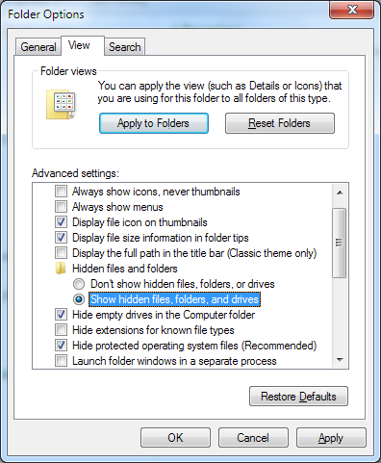
Super hidden files
On the desktop, there is a folder containing embarrassing photos
Its hidden obviously, so let's try and show it
Open a file explorer window, hit ALT to show the toolbar, then goto Tools -> Folder options
Select Show Hidden files

Slide 18
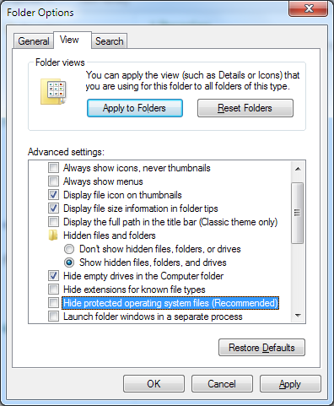
Super Hidden Files
Go back to the desktop and you’ll see that… it's still not there?
Yes, that's because something else was done to it. It has system attributes. Go back to Folder Options and uncheck Hide Protected Operating System Files
You should now see the photos!

Slide 19
Making Super Hidden Files
Its pretty easy, but you have to use a command line tool called attrib.
The command (which must be run as administrator) is
Attrib filename +s +h
+s means make it a system file
+h means make it a hidden file
To convert a file back to normal, do attrib filename -s -h

Slide 20
You’re now a certified h4xx0r!

